Slide 1
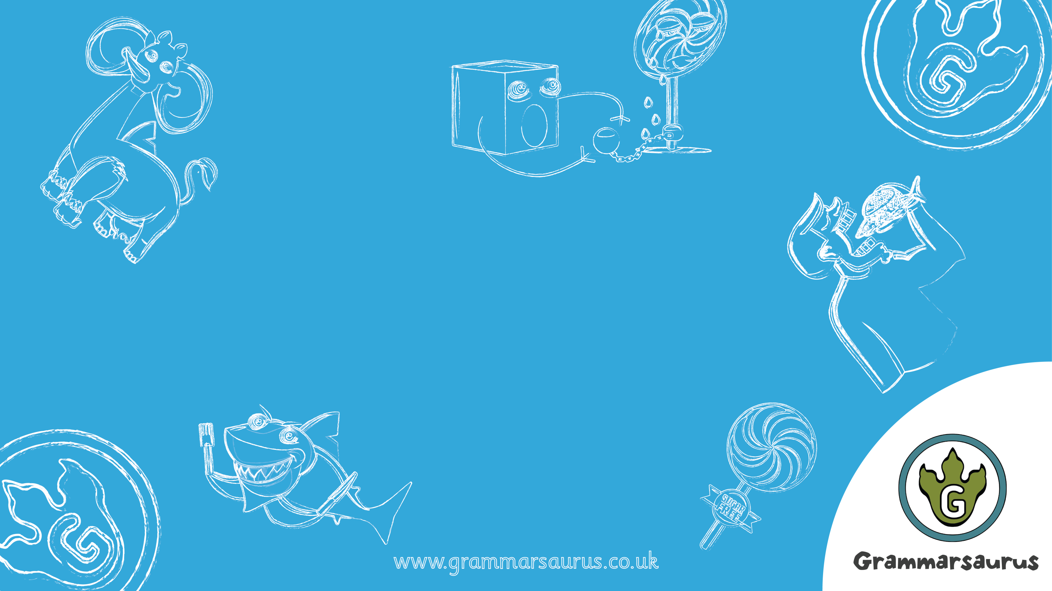
Hyphens

Slide 2
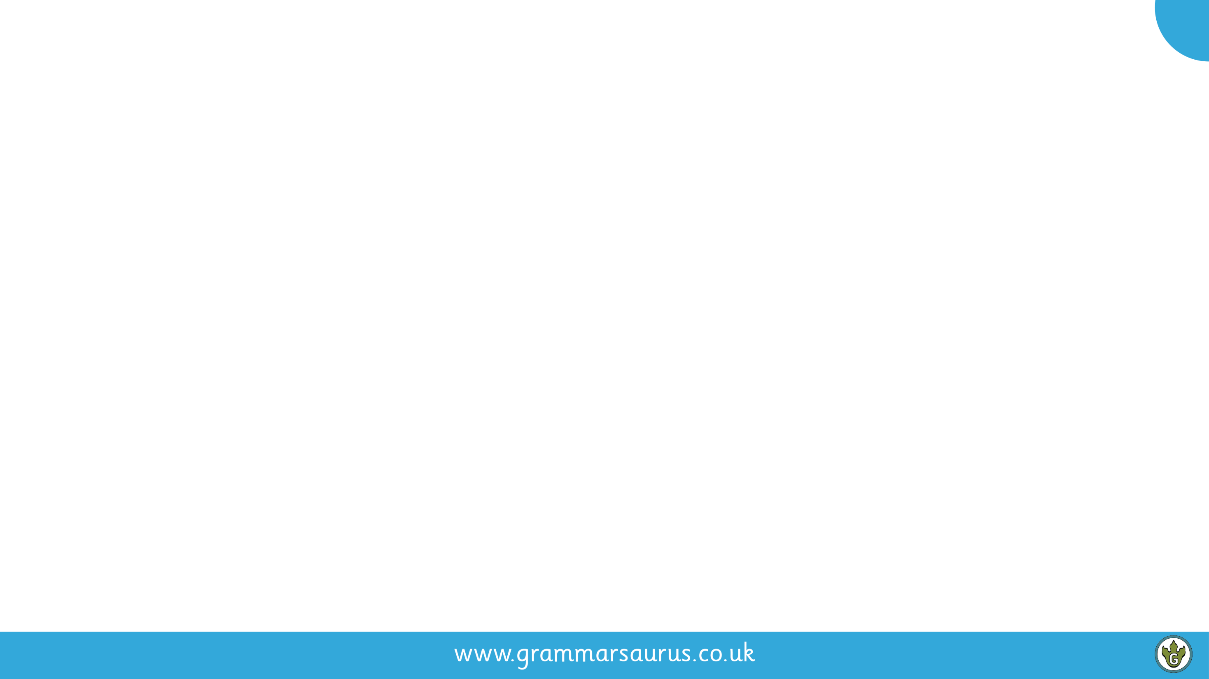
1
Identifying hyphens
Hyphens are used to join together words to create a longer word. They are most commonly used when creating compound adjectives.
Can you spot the compound adjectives in the sentences below?
The man-eating creature uses its razor-sharp claws to capture and kill its prey.
This technologically-advanced software recognises your fingerprint in seconds.
Visiting the moon is a once-in-a-lifetime opportunity for all astronauts.
I prefer drinking sugar-free drinks, as sugar destroys the plaque on your teeth.
Top tip
The easiest way to spot an adjective is to identify the nouns in your sentence and then ask ‘which word/words are describing my noun?’
Did you know?
Compound adjectives create expanded noun phrases!
noun
noun
noun
Notes:
Identify the nouns in each sentence with the children and then identify the adjective before the noun. Please be aware, if your pupils are not 100% clear that adjectives describe a noun, you may want to go back and cover this first. There are five compound adjectives in the examples above: man-eating, razor-sharp, technologically-advanced, once-in-a-lifetime, sugar-free.

Slide 3
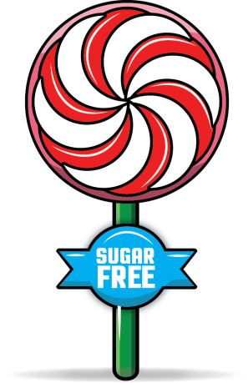
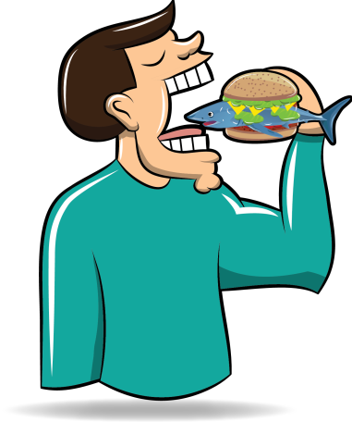
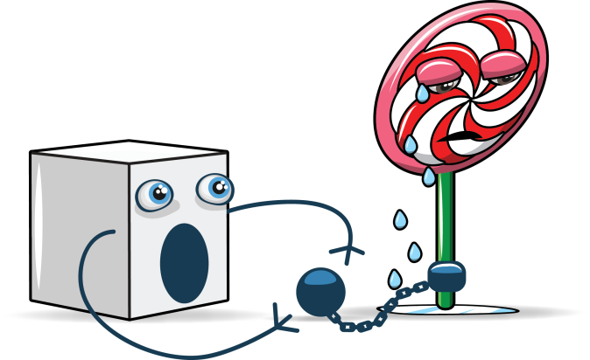

2
Why bother using them?
Without hyphens, some sentences can lose their meaning and it becomes difficult to know what the writer is trying to say. Take a look at some of the examples below:
or
?
or
?
man eating shark
man-eating shark
sugar free lolly
sugar-free lolly
Explain to your partner what the difference is in each picture and then decide what you think the hyphen does to the words before the noun.
Notes:
Man eating shark = subject verb object. Man-eating shark = expanded noun phrase to describe a shark. Sugar free lolly = subject verb object. Sugar-free lolly = expanded noun phrase describing the lolly.

Slide 4
3
Creating compound adjectives
Here are a some words which can be glued together using hyphens to create one longer compound adjective. Use hyphens to create a suitable compound adjective to describe the nouns on the right:
one
old
year
man-eating
shark
toddler
child
hotel
pattern
experience
a
eating
man
kind
of
fashioned
seven
storey
year
Notes:
There are many answers to the slide above. Some examples could be ‘seven-storey hotel’ ‘seven-year-old child’ ‘old-fashioned hotel’ etc.

Slide 5
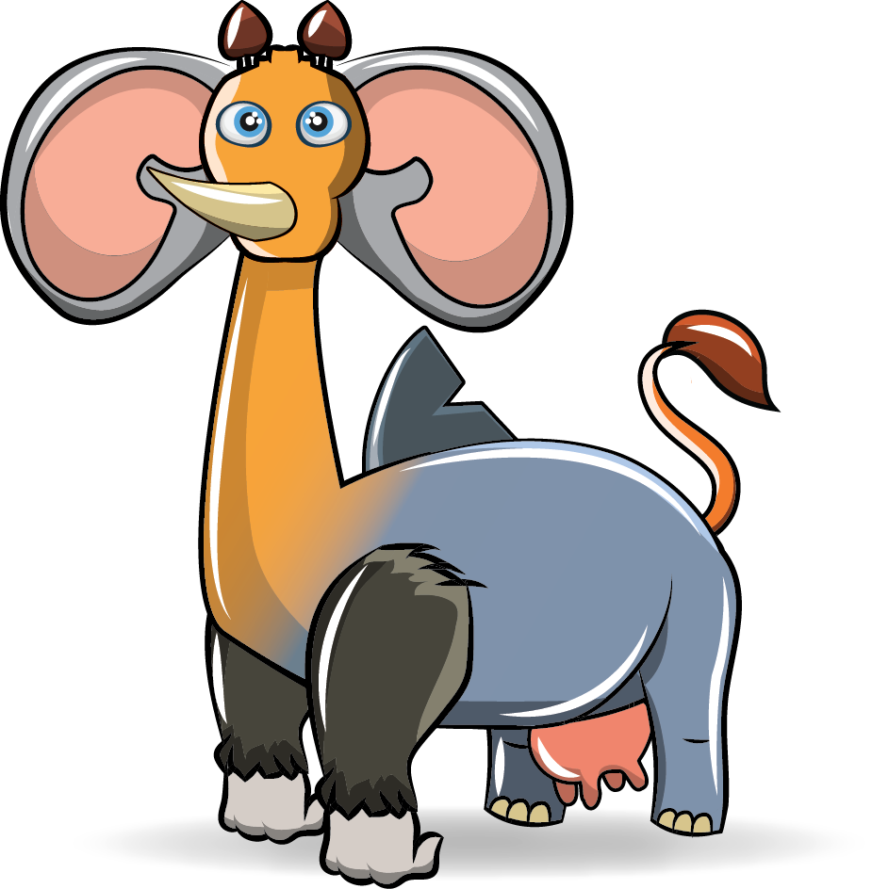
4
Creating compound adjectives
Jeepers! Look at that! This hybrid creature has just been discovered somewhere in the middle of the Amazon Rainforest!
Apparently, you are now hyphen experts and we most certainly need to use some compound adjectives to describe this mesmerising beast!
Your task is to describe the creature using compound adjectives (don’t forget to add the hyphen!)

Slide 6
6
Creating compound adjectives
Adjective + past participle
adjective/adverb/noun +present participle (ing)
short-legged
short-haired
heavy-footed
circle-patterned
slow-moving
never-ending
far-reaching
Compare using -like
Which body part or characteristic (e.g. speed, hunger etc.) might these compound adjectives relate to?
There might be an odd one out! Can you find it?
shark-like
elephant-like
lion-like
Notes:
Be aware that pupils with misconceptions may join together adjectives which must be separated with a comma e.g. angry-ferocious creature instead of angry, ferocious creature. If this is the case, use the next slide to break down the process of building compound adjectives.

Slide 7
7
Creating compound adjectives
Creating compound adjectives
adjective/adverb/noun | - | like (compare) +ed (describe) +ing (describe) | Noun (body part or characteristic)
rhino cone throat | - | like shaped piercing | horn
lion sand fly | - | like coloured swatting | tail
 | -
 | -
 | -
Use the boxing-up grid to help you create your own expanded noun phrases using compound adjectives.
Notes:
Print off this slide and use this as a support for those pupils who need it.

Slide 8
5
Creating compound adjectives
Describe the creature using compound adjectives
(don’t forget to add the hyphen!)
tail
ears
paws
shark-like fin
grey-coloured fin
eyes
horn
Notes:
Further vocabulary work would benefit this section of the PPT. A unit on non-chronological reports would provide ample opportunity to explore vocabulary elements of this punctuation use.

