Slide 1
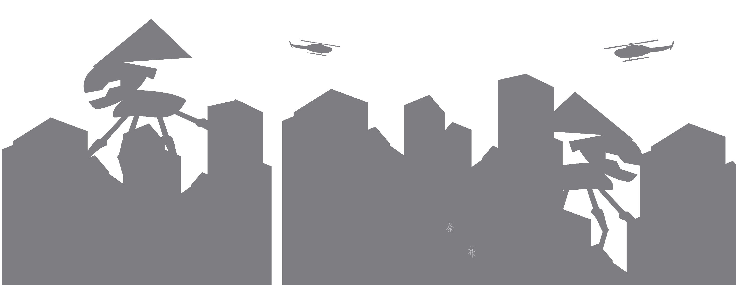

Grammarsaurus
War of the Worlds
Writing Project
UKS2 – KS3

Slide 2

Introduce the audience to the disbelief that aliens could exist and that they have been watching for many years.
Detail the first attack. When did it happen?
What did it look like? Describe its appearance
and the shock of the world as they watched on.
What did experts say? How did the world’s
Governments reassure us? Were they correct?
Leave it on a cliff hanger.
Reading
Use the opening words from Jeff Wayne’s ‘War of the Worlds’ as the reading text for this section.*

Slide 3

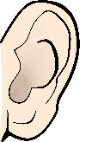

Captivate
In partners, use your captivate mind map to orally retell the opening in three sections:
Speaking and listening
Introduce the audience to the disbelief that aliens could exist and might have been watching our planet for years.
Detail the first attack. When did it happen?
What did it look like?
3. What did the experts says. How did world leaders react?
Were they correct? Leave it on a cliffhanger…
Sentence Prompts
Who would’ve known that..? How could anyone have guessed that..? They watched the Earth and dreamed of… They regarded planet Earth with…
At midnight on the 21st of June, 2016, the first…
Vast amounts of ... shot across the galaxy towards
…that’s how it was for the next ten nights.
World leaders promised us that… Their voices sounded…
1
Use the numbered sentence prompts and the original WAGOLL to help you.
2
“I assure you that everything is under control.
There is no threat from that planet.”
3

Slide 4

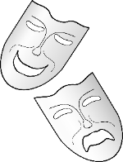
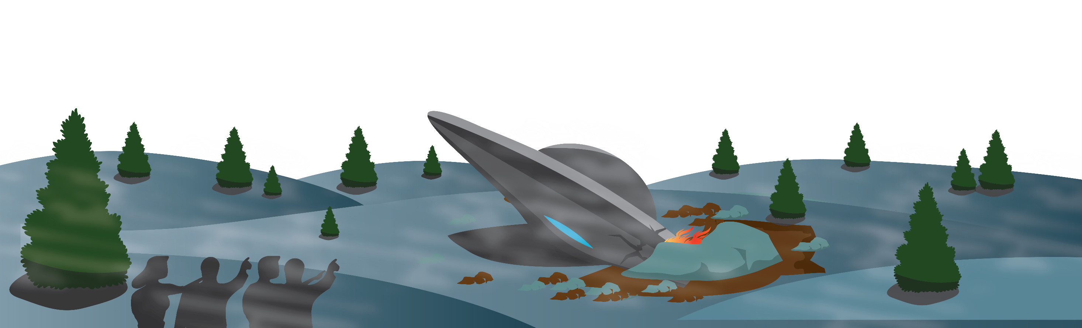
Captivate
Describe the alien as it exits the crash-landed spacecraft – use our sentence structure grid for support.
Create a freeze frame of onlookers. One by one, unfreeze and reveal your character’s thoughts to the audience.
Drama and writing
Quantifier Two A single Eight | Expanded noun phrase luminous, disc-like eyes giant, rotund bulk metallic, writhing tentacles | Verb appeared raised itself jutted out | Adverbial (TRaMP) above the metal rim out of the burning hot ship of the space capsule | . . . .

Slide 5
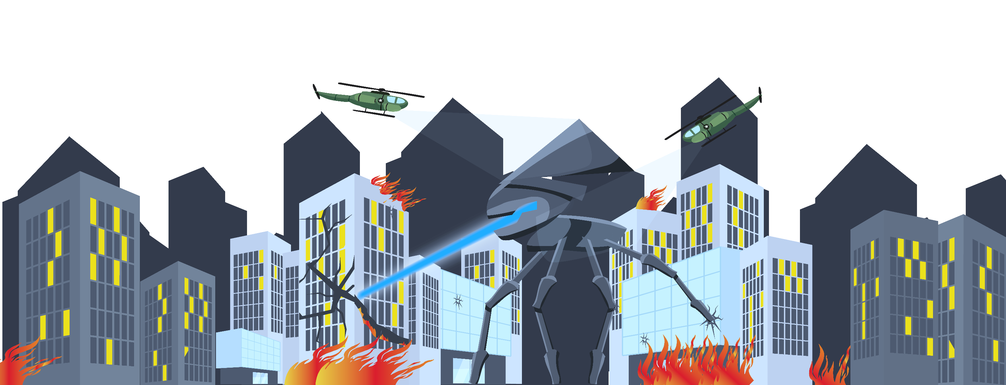
Accelerate
WAGOLL
Across the common, people screamed at the top of their lungs and clawed their way to escape. Chaos took over. Burning heat rays leapt from man to man: evaporating every inch of their body into a fine dust. The stench of burning flesh plagued the nose of every citizen who clambered desperately to escape from the galactic monsters. In complete desperation, a group dived into an open manhole. Would the underground protect them from the enemies above?
Focus writing
Escaping the aliens – focus write 1. Start with an adverbial (TRaMP) 2. Three words only. 3. Begin with a present participle (-ing) and add a colon
4. Include a sense – touch, hear, smell etc. 5. Begin with an adverbial of manner
6. Rhetorical question.

Slide 6
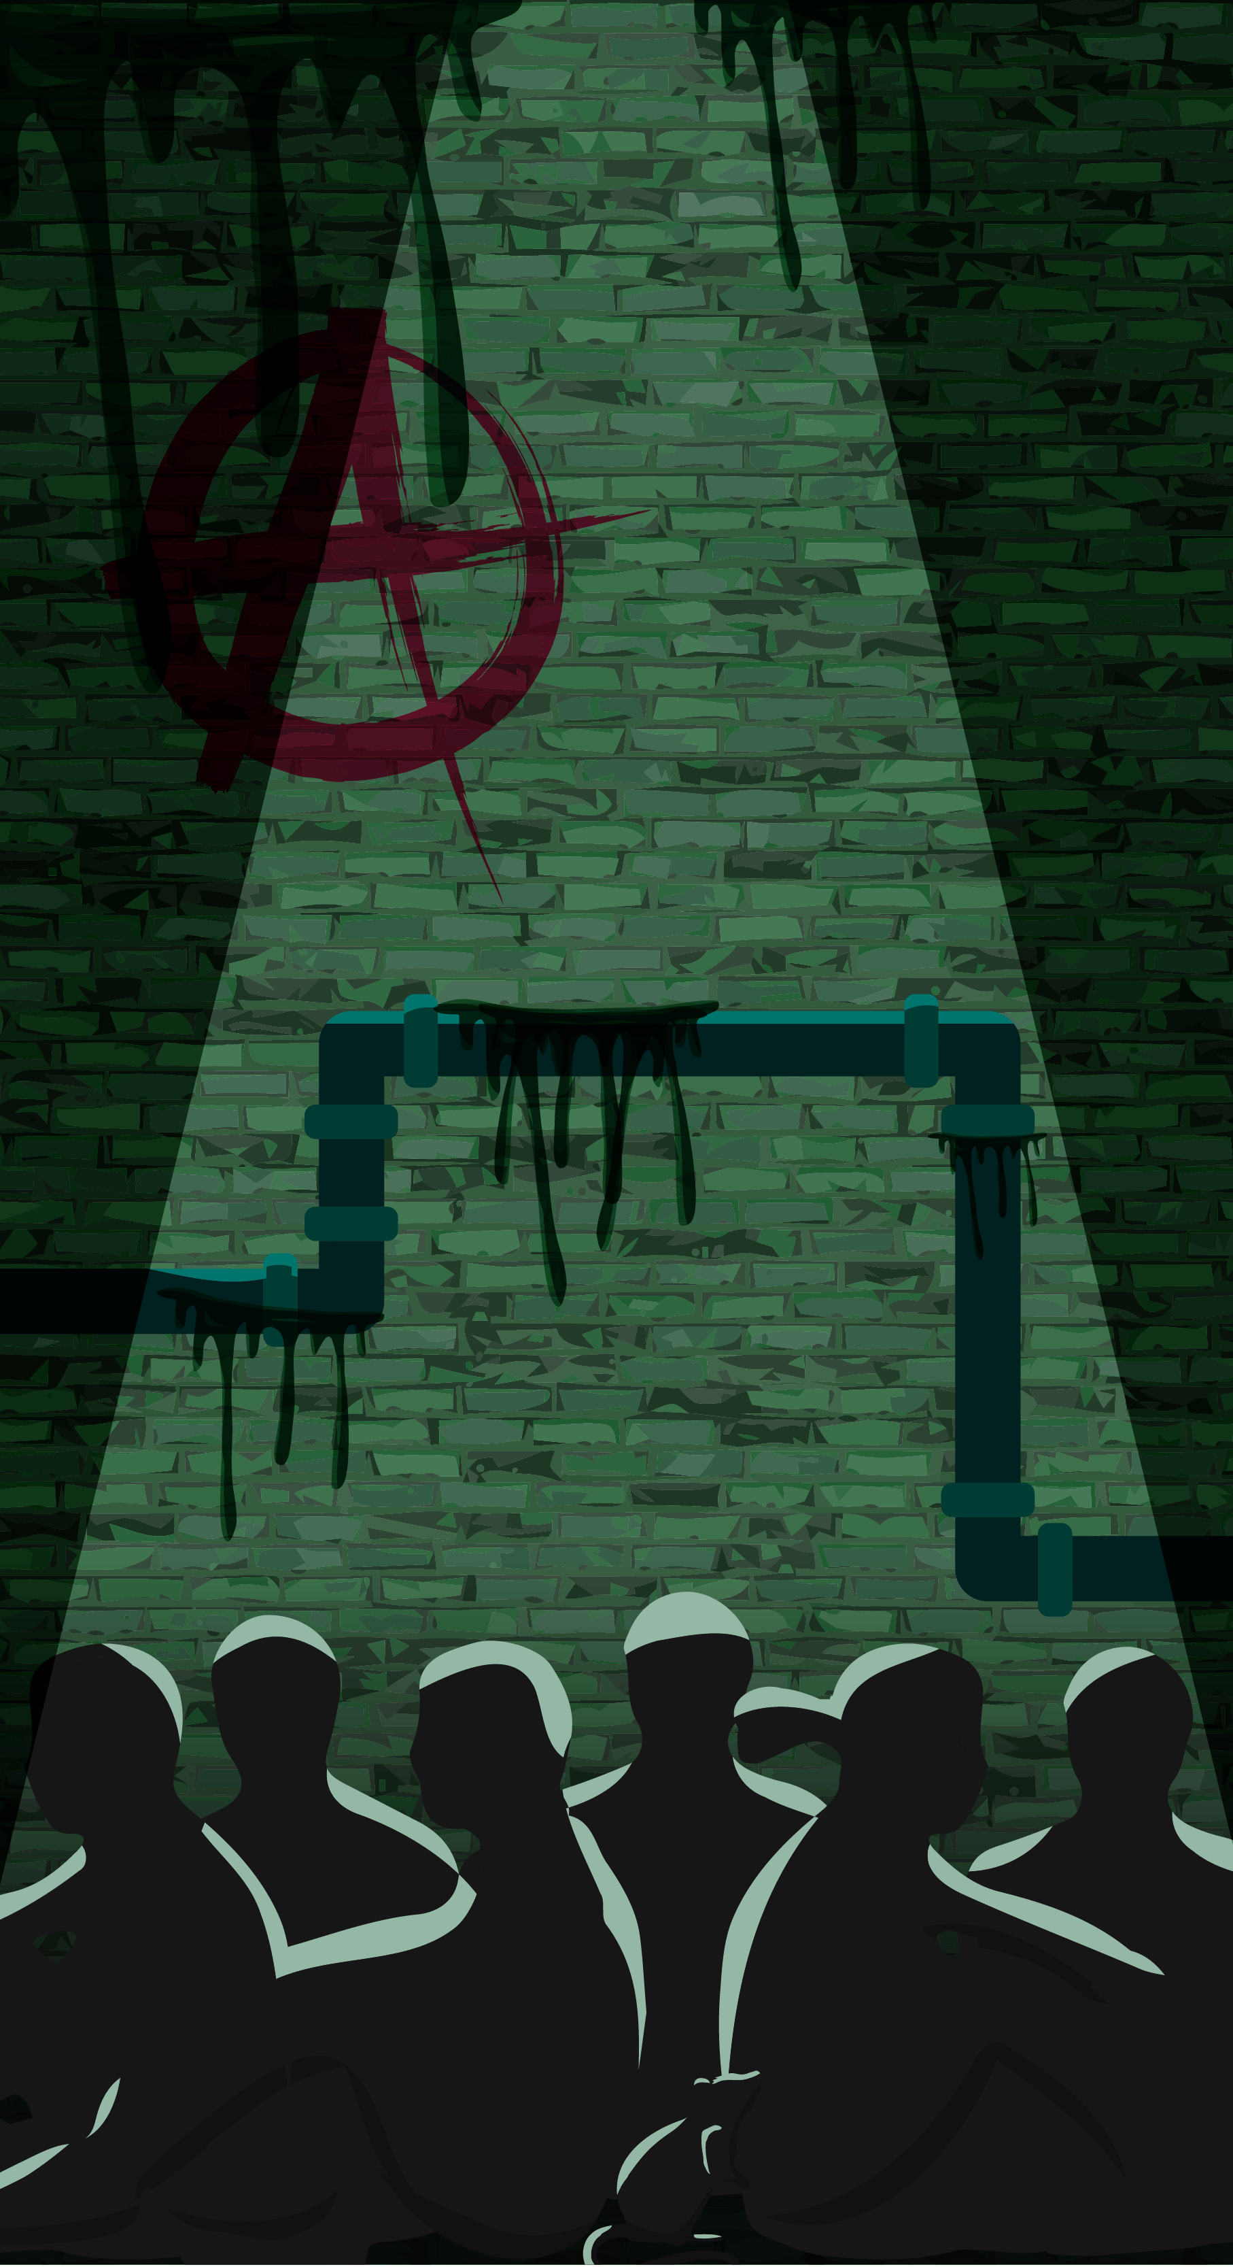
Resonate
Hearing the aliens rampage above – focus writing 1. Start with a preposition phrase. Set the scene
of your hiding spot. Is it light? Smells? Two sentences
maximum.
2. Start the sentence with a emotion. Explain how your characters are feeling. Show don’t tell. Maximum of two lines. How do they feel as they listen? 3. Start with a preposition phrase and use a
colon to list terrifying things you can hear
the aliens doing above ground.
4. Rhetorical question.
Deep under the city streets, a gang of survivors
huddled together in the dim light. An overwhelming stench of sewage now replaced the remnants of burnt flesh in their nostrils. Every one of their
senses were gripped by fear’s vice-like fingers. Breathing heavily, they listened with eyes agape at the torturous noises bellowing through the open man-hole that had rescued them: monstrous mechanical screams erupted from the galactic beasts and blood-curdling screams resonated
from their terrified prey. Would these petrified six survive the night?
Focus writing

